Slide 1
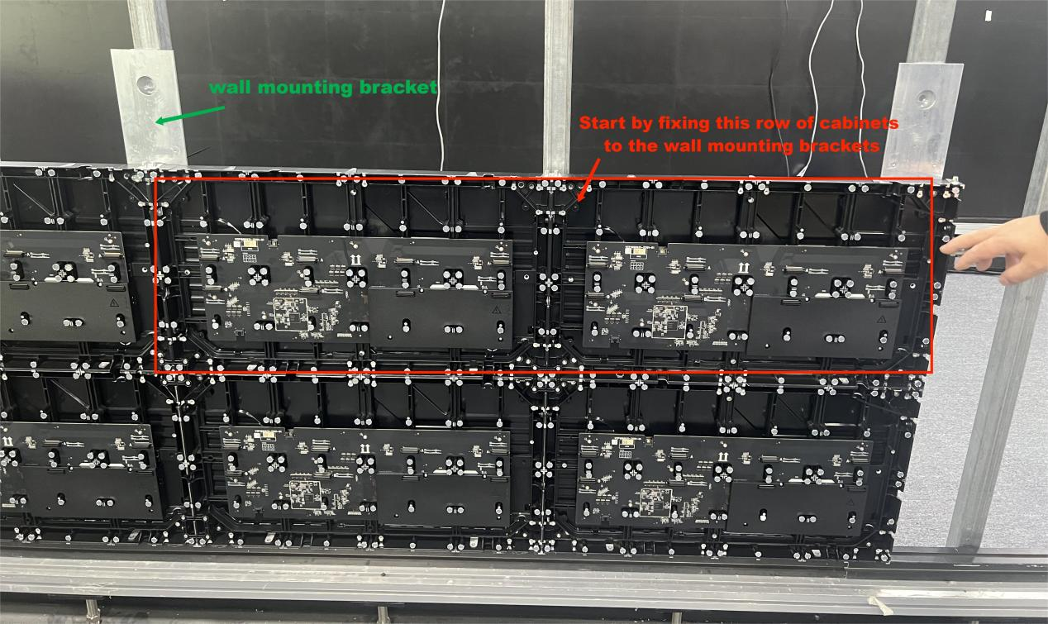
UT-C SERIES
Fine Pitch LED Display
Installation Manual
Wall-mounted cabinet installation / Cabinet connection / Module installation
A4 PORTRAIT | ENGLISH VERSION

Slide 2
STEP 01
Installation of Wall Mounting Bracket
01
Fix the wall mounting bracket to the wall with expansion screws.
02
Start by fixing the middle row of cabinets to the wall mounting brackets.
03
Keep the middle row aligned before continuing with the remaining cabinets.
UT-C Series Fine Pitch LED Display Installation Manual
01

Slide 3
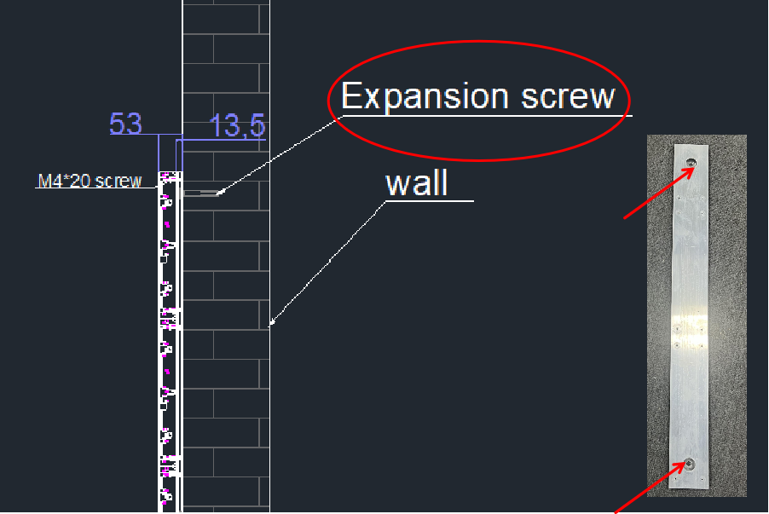
STEP 02
Wall Bracket Fixing Detail
01
Use the expansion screw positions shown in the bracket drawing.
02
Confirm the bracket is firmly fixed before cabinet installation.
03
Do not hang cabinets until the wall bracket is secured.
UT-C Series Fine Pitch LED Display Installation Manual
02

Slide 4
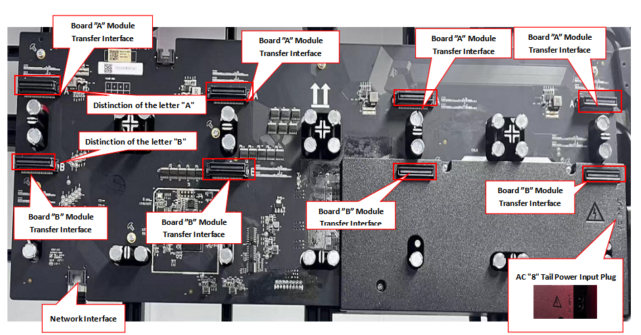
STEP 03
Cabinet Port Layout
NETWORK
MODULE
POWER
Network interface
Board A/B module transfer interface
AC '8' tail power input plug
01
Identify the network interface before routing signal cables.
02
Match Board A/B interfaces according to the cabinet markings.
03
Confirm the AC '8' tail power input plug before power connection.
UT-C Series Fine Pitch LED Display Installation Manual
03

Slide 5
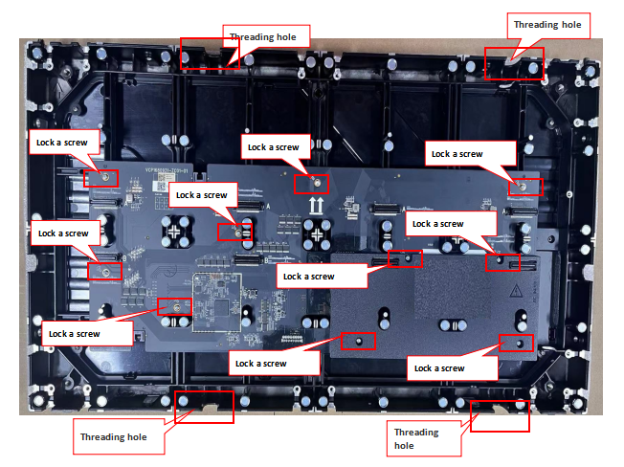
STEP 04
Fixing the One-piece Board
01
Place the one-piece power adapter board on the front of the cabinet.
02
Align the board with the threading holes and screw positions.
03
Lock the screws at the marked positions to secure the board.
UT-C Series Fine Pitch LED Display Installation Manual
04

Slide 6
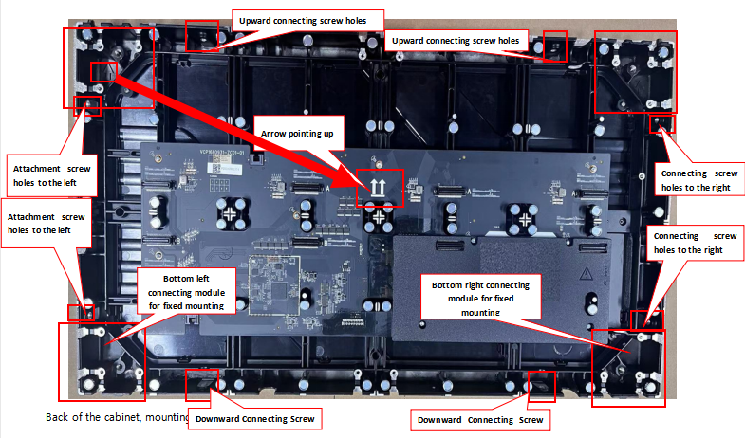
STEP 05
Cabinet Mounting Structure and Direction
01
Keep the arrow mark pointing upward during installation.
02
Confirm upper, lower, left and right connecting screw holes before cabinet connection.
03
Use the fixed-mounting corner modules at the marked cabinet positions.
UT-C Series Fine Pitch LED Display Installation Manual
05

Slide 7
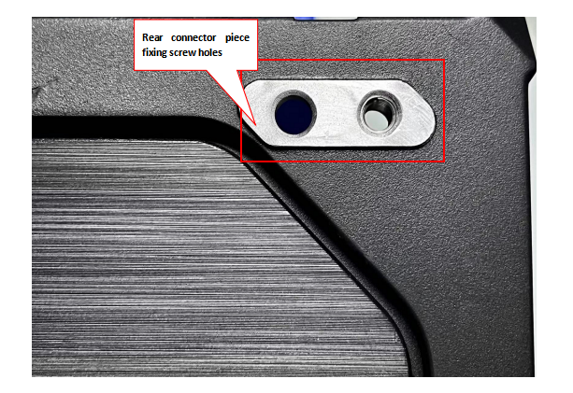
STEP 06
Rear Connector Piece Fixing Hole
01
Locate the rear connector piece fixing screw holes on the back of the cabinet.
02
Use the rear connector piece position for cabinet and bracket fixing.
UT-C Series Fine Pitch LED Display Installation Manual
06

Slide 8
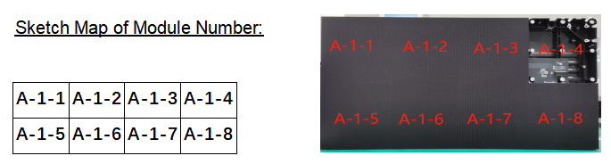
STEP 07
Cabinet Position and Module Numbering
E-1
E-2
E-3
E-4
E-5
D-1
D-2
D-3
D-4
D-5
C-1
C-2
C-3
C-4
C-5
B-1
B-2
B-3
B-4
B-5
Module numbering reference
A-1
A-2
A-3
A-4
A-5
A-1-1
A-1-2
A-1-3
A-1-4
A-1-5
A-1-6
A-1-7
A-1-8
Module number example
01
Confirm cabinet position numbers before installation.
02
Confirm the corresponding module number before installing modules.
03
Install modules according to the cabinet and module numbering reference.
UT-C Series Fine Pitch LED Display Installation Manual
07

Slide 9
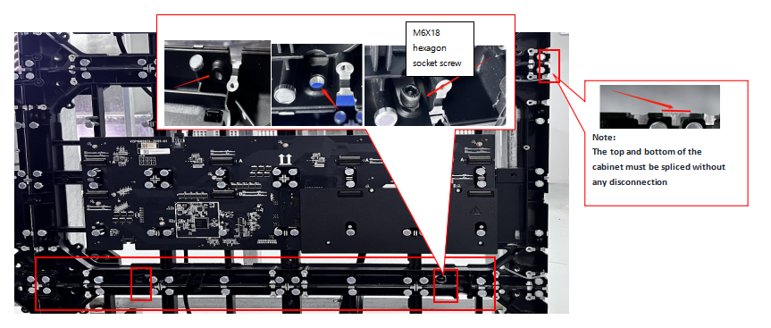
STEP 08
Connecting Left and Right Cabinets
FASTENER
ALIGNMENT
2 x M6x18 hexagon socket screws
Top and bottom surfaces flush
01
Connect two adjacent cabinets using 2 M6x18 hexagon socket screws.
02
Fix the screws first, but do not fully tighten them.
03
Adjust the cabinet tops to the same plane, then tighten the screws.
UT-C Series Fine Pitch LED Display Installation Manual
08

Slide 10
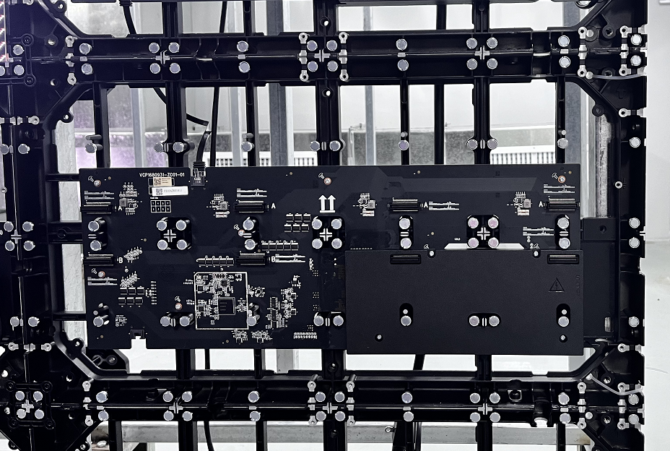
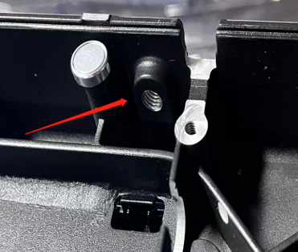
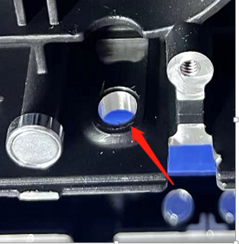
STEP 09
Connecting Upper and Lower Cabinets
Upper/lower connection fixing points
FASTENER
ALIGNMENT
2 x M6x18 hexagon socket screws
Side surfaces flush
01
Connect the upper and lower cabinets using 2 M6x18 hexagon socket screws.
02
Fix the screws first, but do not fully tighten them.
03
Adjust the cabinet sides to the same plane, then tighten the screws.
UT-C Series Fine Pitch LED Display Installation Manual
09

Slide 11
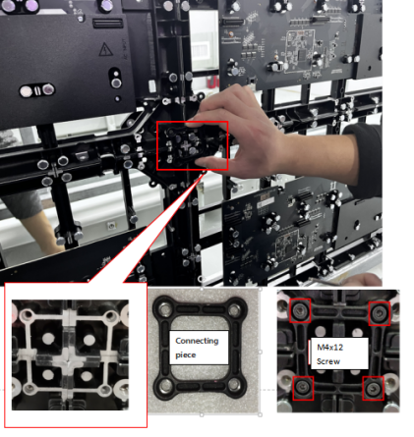
STEP 10
Installing the Front Connecting Piece
FASTENER
POSITION
4 x M4x12 hexagon socket screws
Cabinet connection joint
01
Place the front connecting piece at the cabinet joint.
02
Use 4 M4x12 hexagon socket screws to fix the connecting piece.
03
Confirm the connecting piece is fully seated before proceeding.
UT-C Series Fine Pitch LED Display Installation Manual
10

Slide 12
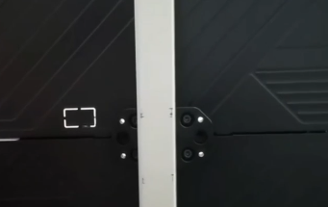
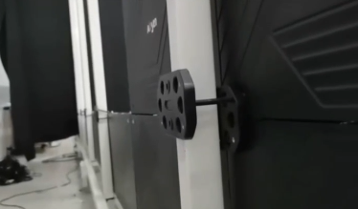
STEP 11
Rear Connecting Piece and Wall Bracket Fixing
Rear connector piece fixing position
01
Use one rear connecting piece to fix four cabinets together.
02
Fix the other rear connecting piece to the wall mounting bracket.
03
Confirm the cabinet connection and wall bracket fixing are both secured.
UT-C Series Fine Pitch LED Display Installation Manual
11

Slide 13
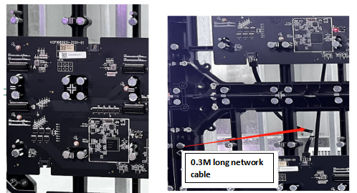
STEP 12
Installing the Network Cable
CABLE
CONNECTION
0.3 m network cable
Upper and lower adjacent cabinets
01
After cabinet installation, connect adjacent upper and lower cabinets.
02
Use a 0.3 m network cable for the connection shown in the figure.
03
Confirm the network cable is fully inserted into the interface.
UT-C Series Fine Pitch LED Display Installation Manual
12

Slide 14
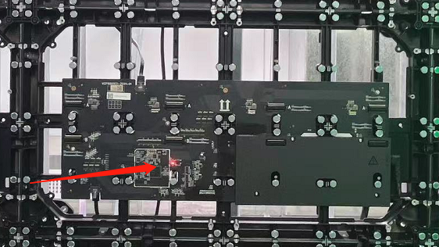
STEP 13
Connecting the Power Cable
INPUT
ROUTING
AC mains input from the top cabinet
One AC main input cable per vertical row
01
Connect the power cables between the two cabinets and plug them into position.
02
Access the AC mains input power cable from the top-most cabinet power connector.
03
Use one AC main input power cable for one vertical row.
UT-C Series Fine Pitch LED Display Installation Manual
13

Slide 15
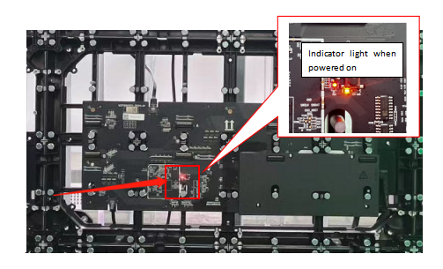
STEP 14
Checking Wiring Connections
01
After installing the power cable and network cable, check every cabinet.
02
Verify that the power board indicator light is on and flashing normally.
03
If the indicator is off or flashes abnormally, check the power supply and network connection.
UT-C Series Fine Pitch LED Display Installation Manual
14

Slide 16
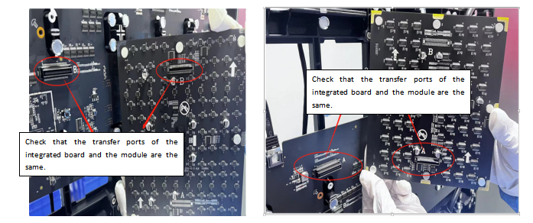
STEP 15
Installing the LED Module
01
Check the mounting direction arrow on the module and place the arrow facing upward.
02
Fix the module to the magnetic columns on the cabinet.
03
Align the module transfer interface with the cabinet interface.
04
Match the row plug and pins before pressing the module into place.
Do not force the module into place.
UT-C Series Fine Pitch LED Display Installation Manual
15

Slide 17
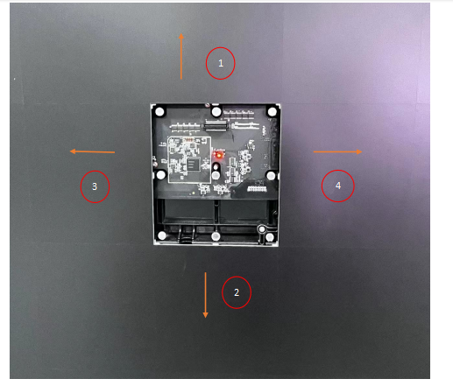
STEP 16
Removing a Module in the Middle Area
01
Disconnect power and wait for the screen to cool before removing a faulty module.
02
If the module is difficult to remove, push the adjacent modules upward, downward, left and right first.
03
Remove the module after the surrounding modules have been released.
UT-C Series Fine Pitch LED Display Installation Manual
16

Slide 18
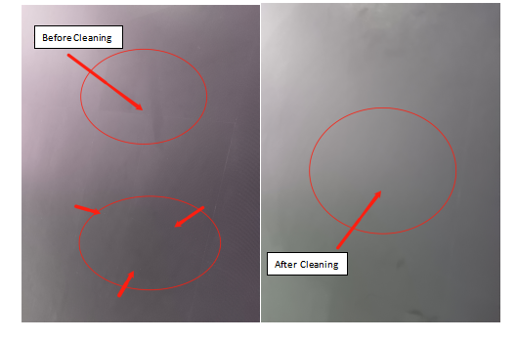
STEP 17
Surface Cleaning After Installation
01
Clean dust, dirt and fingerprints from the installed surface.
02
Use alcohol and dust-free cloth for cleaning.
03
Clean carefully to avoid corrosion, scratching or damage to the LED module.
UT-C Series Fine Pitch LED Display Installation Manual
17

